Slide 1
HarNice!
The free, open-source electrical system design tool.

Slide 2
Disclaimer
I wrote this in past tense, but it’s far from done!
This is my first-ever real coding project
I don’t claim that my code is any good – just the thoughts!
I’ve never really used another real system-engineering tool
Maybe I’m reinventing a wheel
Either way, it’s a super fun project

Slide 3
What is an electrical system?
Battery
Any collection of circuit boards, devices, other things, that connect to each other with wires or harnesses
Requires engineering trades and decisions to design
Examples:
Avionics system on a rocket or satellite
Vehicle HITL
Test stand
Concert sound system
Residential AC power distribution
Flight computer
Power distribution unit
Network switch
Actuator controller
Sensor DAC unit
Actuator
Pressure sensor
Pressure sensor
Pressure sensor

Slide 4
What is not an electrical system?
Physical electrical behavior
We take the assumption that any device has inputs and outputs and what it does to relate the two is not part of “system engineering”
Network routing
Software configs are agnostic to the electrical systems

Slide 5
How do you design your system?
The competition:
Zuken, E-plan, etc
SUPER expensive, cumbersome, training-intensive
Pen and paper vibes
Alternatively, Vizio, Powerpoint, Excel, MS Paint
No metadata in your drawings
No enforceable design rule checks
Conflicting sources of truth
Required manual dependencies
No centralized revision control

Slide 6
Harnice solves this.
There can and should always exist one single source of truth for any entire electrical system.
On the assumption that the following are known, every artifact (harness drawing, BOM, etc) should be fully deterministic.
Your system is fully defined
You know how many devices you need and how you want them to be connected
You have complete details about how each device works
Device connectors and channels are fully defined
Every design standard you adhere to is expressible
Ex. “We always put yellow heat shrink if the harness contains a signal with this name”
Ex. “Every time a harness contains more than two receptacle connectors, switch the font size on the label”
The physical routing of harnesses in 2D or 3D is defined somehow
Harnice doesn’t know how long a harness needs to be

Slide 7
How do you know what to design?
Traditionally, the engineer compiles information either from a design guide, from industry knowledge, or other sources,
…manually…
until their design is complete.
INSTEAD:
Harnice encourages the user NOT to compile any information, and instead, explicitly document your design standards and rules in a machine-readable format.
Let the machines work for you!

Slide 8
High-level requirements
Harnice shall have just one command which should update everything about a product
Harnice shall allow users to input their design rules using a well-known human-readable language
Harnice may only produce ONE deterministic solution to any product, and raise an error if multiple or zero solutions are found
Harnice shall not operate on released parts`

Slide 9
Flexibility requirements
If you can define something as an “instance” with “attributes”, it should be able to end up in a harness build file.
Harnice shall minimize the number of terms that represent physical goods (see prev. slide)

Slide 10
The solution
Kicad
You specify your system using Kicad or Altium
Components represent devices
Nets represent harnesses
Harnice runs a bunch of code on your netlist to determine harness requirements
Builds a channel map
Builds a System Instances List (list of every part and every connection for every harness)
Harnice harness editor can look for a harness inside a system
Adds parts based on standard build rules
Exports build drawings and other artifacts instantaneously
Device definitions
Netlist
Channel definitions
Channel map
Company build rules
System instances list
Artifact build rules
Harness instances list
Harness drawing

Slide 11
a word on terminology…

Slide 12
Term | Description | Scope | Attributes | Examples
“System” | A complete overview of every relevant piece of hardware in your system | Systems contain devices and nets | Which device part numbers and how many are you using How each device is connected to each other | Vehicle HITL Test stand Concert sound system Residential AC power distribution
“Device” | A physical device that interfaces with other devices via hardware electrical signals |  | Part number Connectors Channels | Pressure sensor ADC Light switch MacBook
“Channel” | A set of signals | Devices have Channels Channels exist in a centralized library Channels are not allowed across multiple connectors yet | Other compatible channels Input, output, or both Range, tolerance Data format | “Power in” “Mic level signal” FTT (4-20mA) 500mHz 50ohm
“Signal” | An individual conductor going in or out of a device | Channels are defined to contain Signals Device Connectors must contain all device Channels’ Signals | Signal name | +5V Chassis CS, MISO, MOSI
“Net” | A set of connectors | Nets defined at the system-level Nets are not harness part numbers | Which connectors of which devices are included in the net | N$1
“Harness” | A physical device that exists to link devices together | Harnesses contain Circuits and mating connectors | Harness part number Contained parts | Lightning cable Your favorite octopus harness
“Circuit” | A connection between one signal and another | Circuits contain contacts, conductors, etc that form an electrical path | Name | Channel 1 +5V

Slide 13
The workflow
User editable per product
Harnice module
System instances list if relevant
Import from library
Generated file
harnice --render <product>
Input file(s) if relevant
Regardless of which product you’re working on, when you call “render”, harnice will run “featuretree.py”
Feature Tree, notionally based on Solidworks, will sequentially build up the product’s data structure based on “prebuilders” you can write and select
Feature Tree will also call Artifact Builders, which do stuff like generate a BOM, make a PDF drawing, etc
Part number feature_tree.py
Part(s) if relevant
Prebuilder .py
Prebuilder .py
Prebuilder .py
Product data structure
Flagnotes, tblocks if relevant
Artifact builder .py
Artifact builder .py
Output file
Artifact builder .py
Output file
Output file

Slide 14
Harnice products
 | System | Harness | Device | Part | Title block | Flagnote
Inputs | Netlist exported from Kicad or Altium | System instances list, manual YAML or JSON harness definition | ICD.py |  | Params.json | Params.json
Data structure | Instances list | Instances list | Signals list
Outputs |  |  | .Kicad_sym | Attributes.json Drawing.svg | Attributes.json Drawing.svg | Drawing.svg

Slide 15
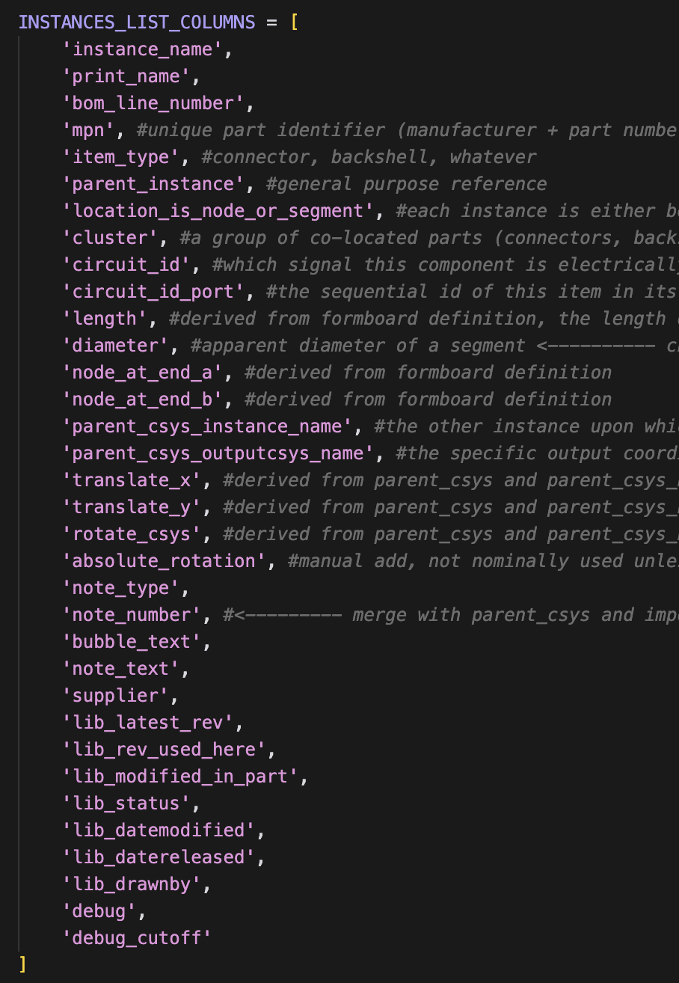
“Instances Lists” as data structures
Harnesses and Systems use “Instances Lists”
A list of every single item, idea, note, part, instruction, circuit, literally anything that comprehensively describes how to build that harness or system
TSV (tab-separated-values, big spreadsheet)
Declined alternatives: STEP files, schematics, dictionaries not general, descriptive, or human readable enough

Slide 16
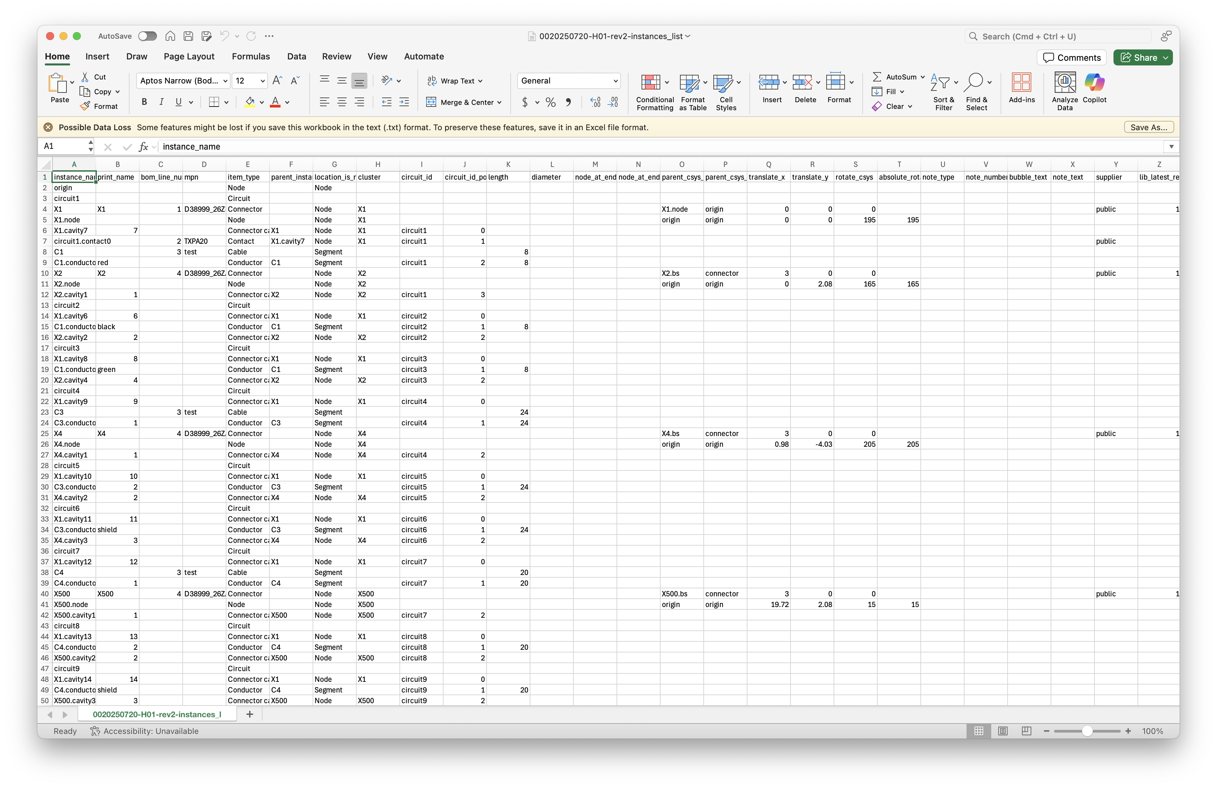
Harness Instances List example

Slide 17
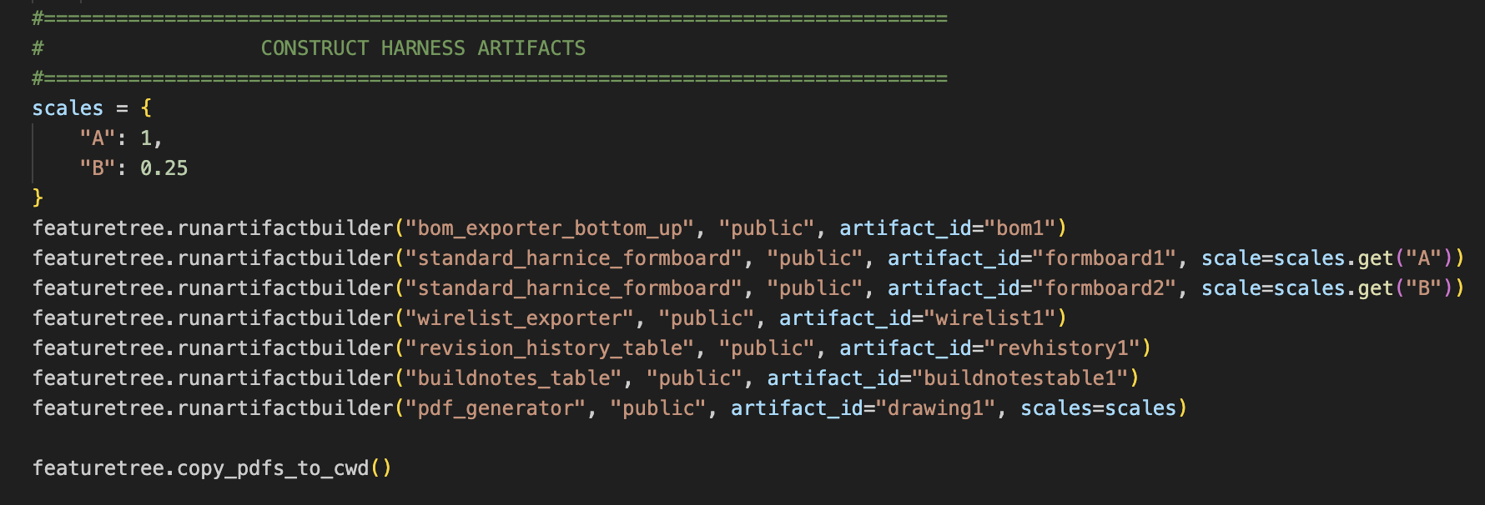
Artifact builders
Artifact builders will scour the Instances List or other artifact outputs and make other things out of it
BOM
Formboard arrangement
PDF drawing sheet
Analysis calcs
Write your own!

Slide 18
Prebuilders
Prebuilders are pre-written “macros” that actively add or modify lines on an instances list.
Can read information from the instances list
Can read information from other support files
Examples
featuretree.runprebuilder(“wireviz_yaml_prebuilder”, “public”)
Reads a wireviz YAML (another commonly used harness design format)
featuretree.runprebuilder(“add_yellow_htshrk_to_plugs”, “kenyonshutt”)
You can write any rule or set of rules you want in Python, save it to your library, and call it from a harness feature tree.
This one, for example, might scour the instances list:
for plug in instances_list:
if item_type==plug:
instances_list.add(heatshrink, to cable near plug)

Slide 19
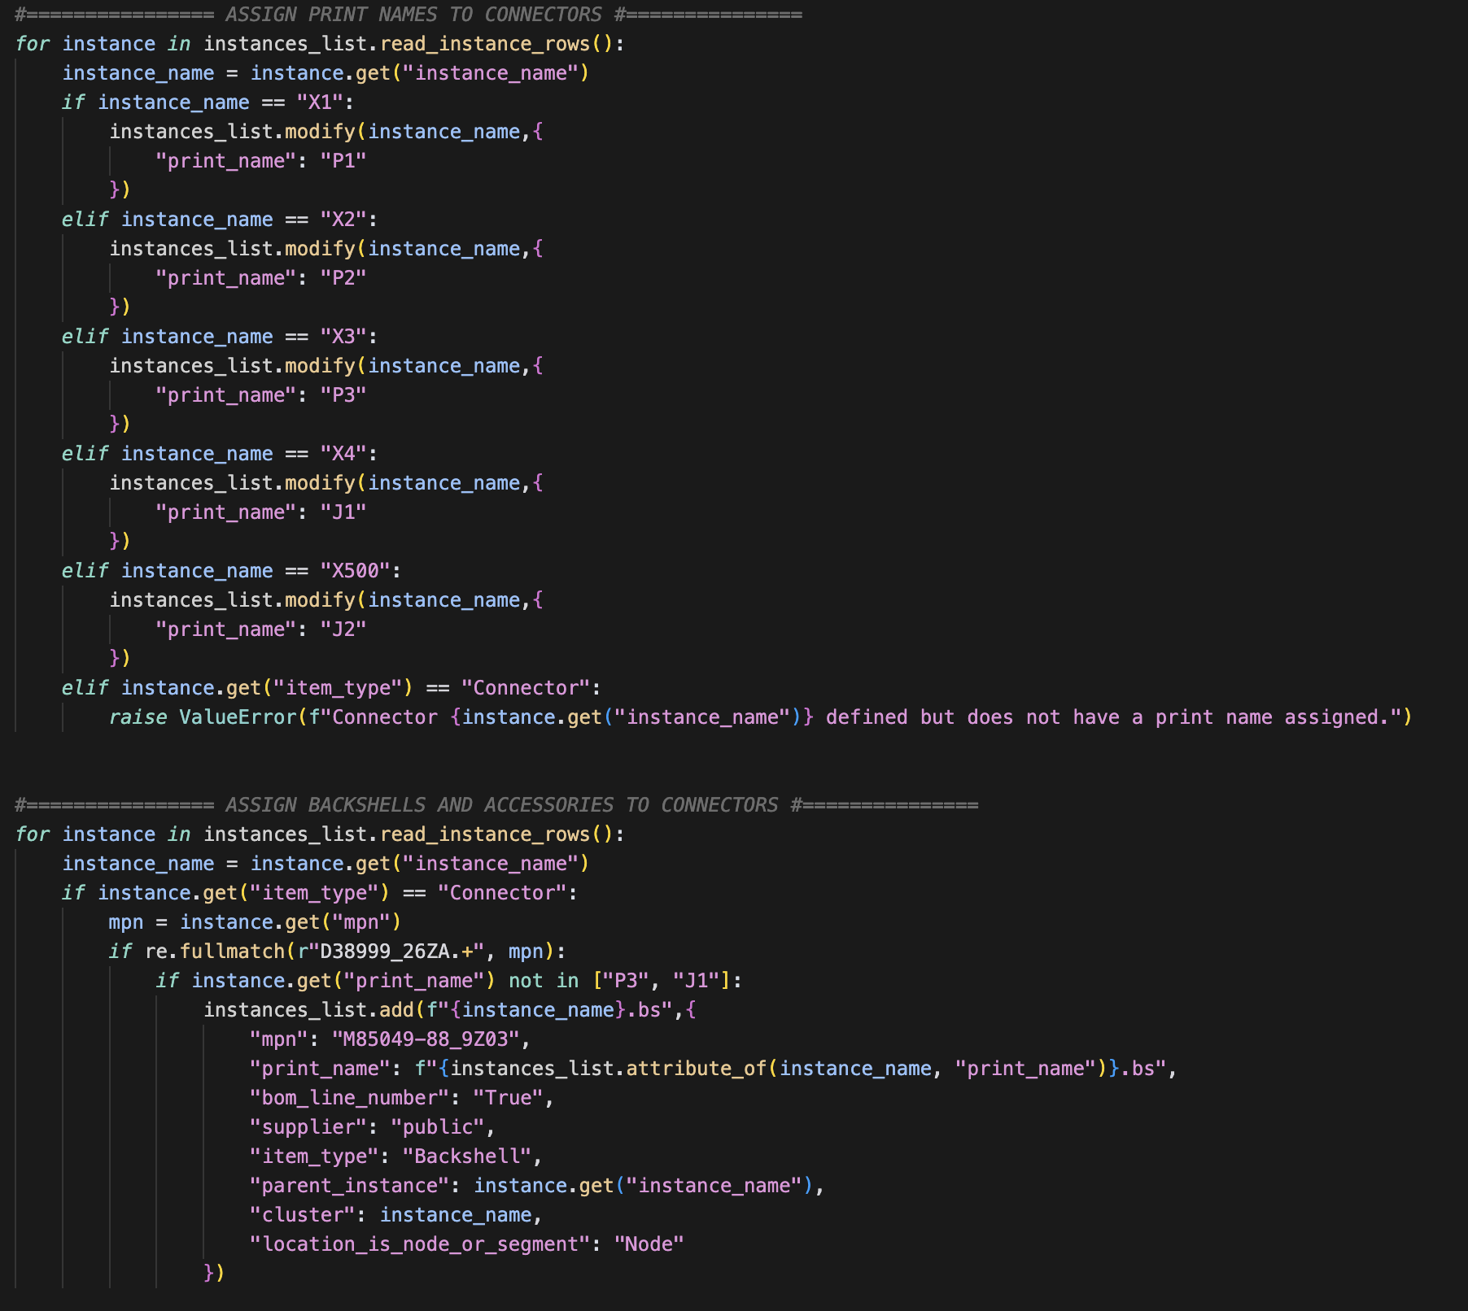
Prebuilders

Slide 20
Harnice workflow – for systems
User editable per product
Harnice module
Import from library
Generated file
Netlist from Kicad
harnice --render system
Part number feature_tree.py
Your preferences for mating connectors
Prebuilder .py
System instances list
Channel map assignment instructions
Prebuilder .py
System instances list
Weird rules you might need
Prebuilder .py
System instances list
Prebuilder .py
System instances list

Slide 21
Harnice workflow – for harnesses
User editable per product
Harnice module
Import from library
Generated file
System instances list
harnice --render system
Part number feature_tree.py
Your weird build rules for this project
Prebuilder .py
Your company’s build rules
Harness instances list
Prebuilder .py
Harness instances list
Prebuilder .py
Harness instances list
Artifact builder .py
PDF drawing
Artifact builder .py
BOM
Artifact builder .py
Vdrop calcs idk

Slide 22
Libraries
Parts, prebuilders, artifact builders, etc, should be re-used and referenced for any future use
Users are heavily encouraged to contribute to the public git repo for your cots parts
harnice-library-public
However, you can define paths to as many library repos as you want.
my-company-harnice-library
my-super-top-secret-harnice-library
You don’t even have to use git to control it!

Slide 23
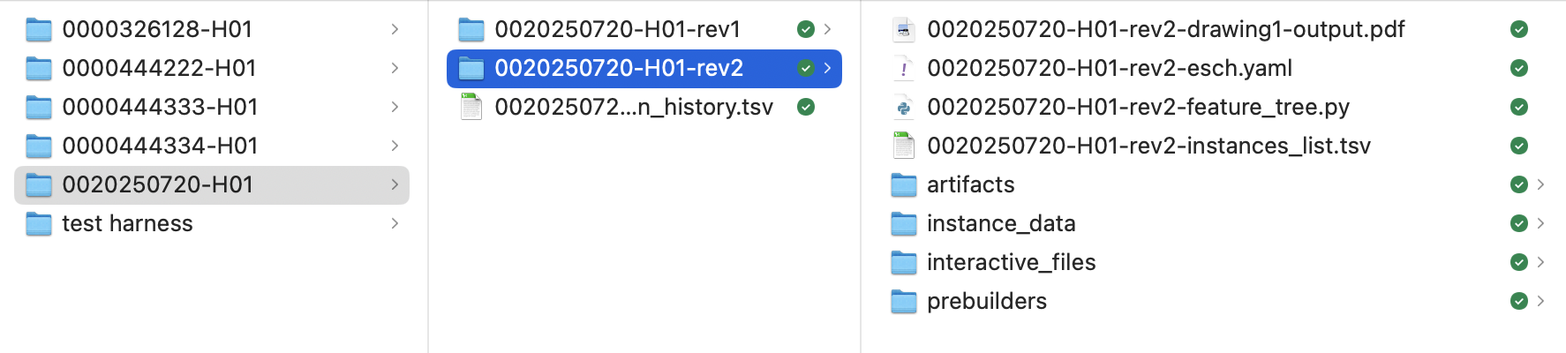
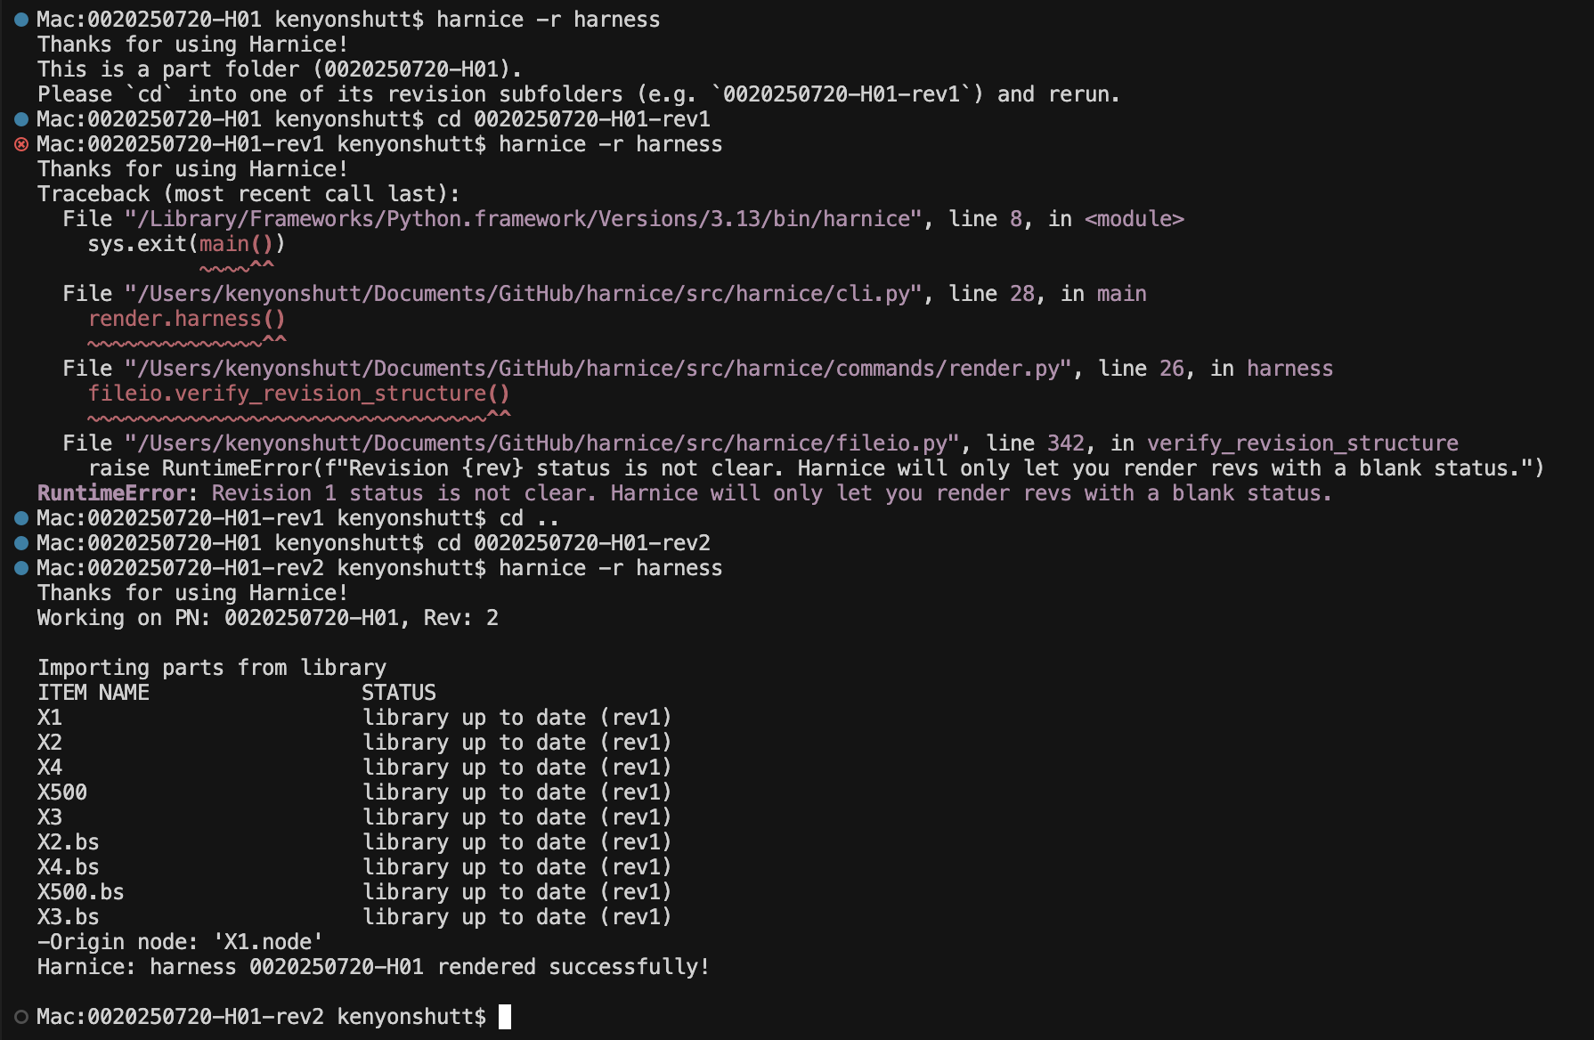
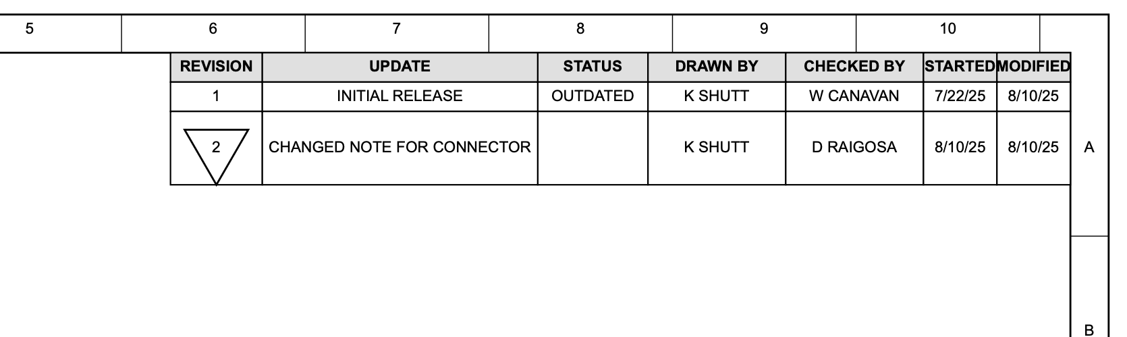
Product version control
To “render” a product (harness, part, etc) with Harnice, the CLI will force you to operate in a “rev folder”
Revision data always stored in revision_history.tsv
Revisions can be referenced elsewhere, ex in pdf_generator

Slide 24
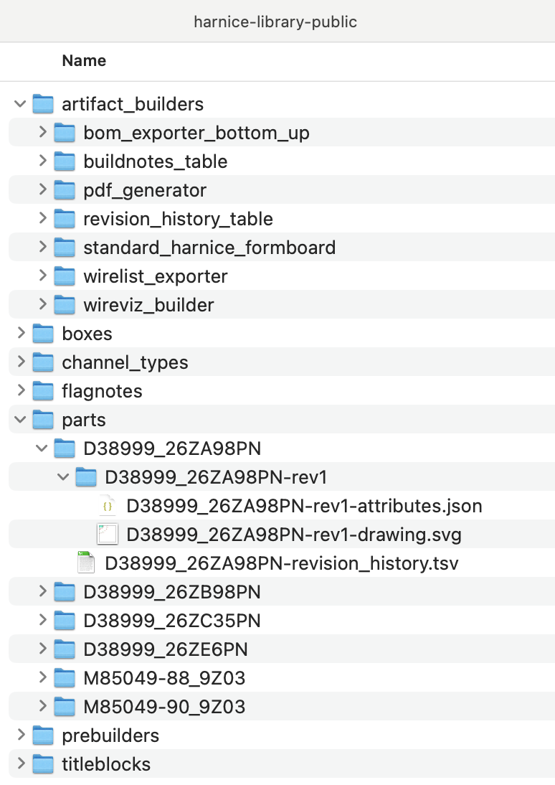
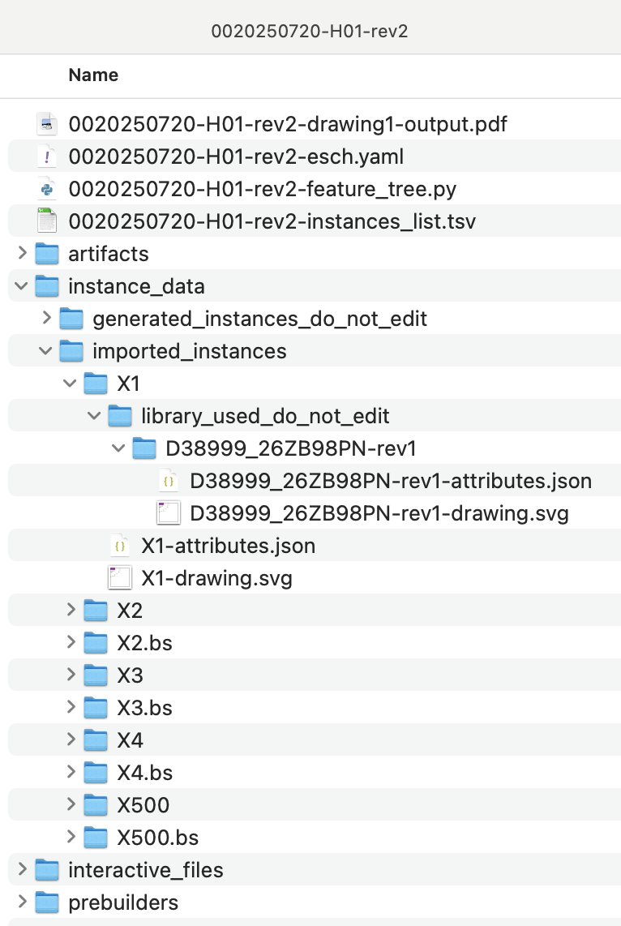
Library flexibility
All parts in a library are version controlled per previous slide…
When importing an item from library, you can request different versions or overwrite imported libraries flexibly…
Library will be imported new at every Render for traceability purposes
User-editable copy (instances_list tracks “modified” from imported library)
revision_history.tsv to track all revisions of a product
Different instances, even with the same MPN, are imported separately
All imported items work the same way

Slide 25
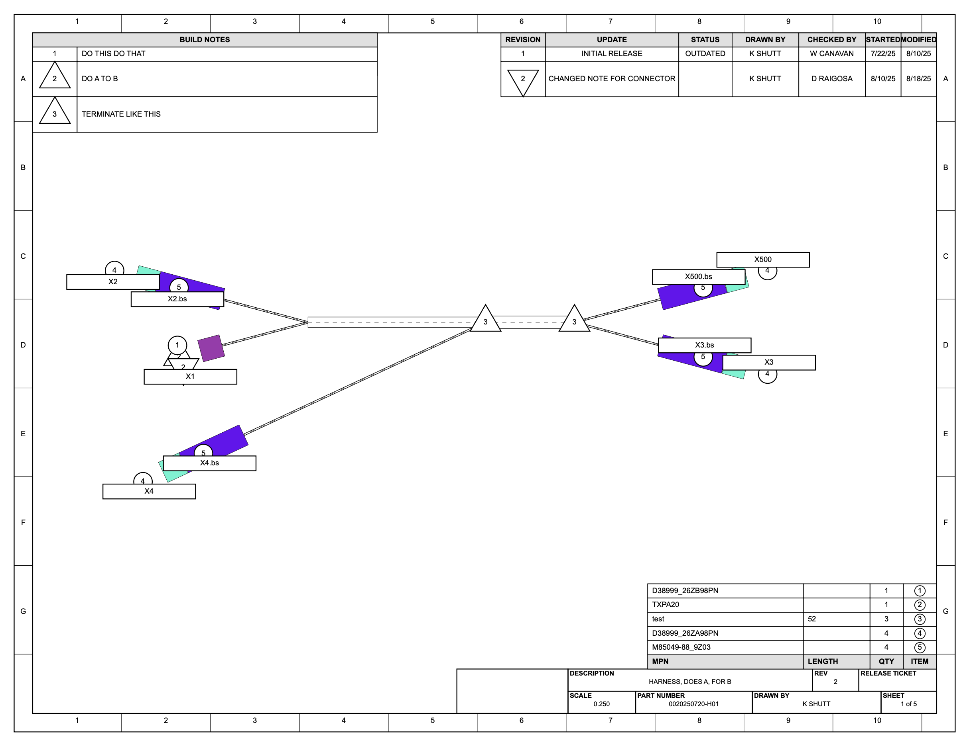
Show me what you can do!
Here’s an output from artifact_builder called “pdf_generator”.
It compiled the outputs of other artifact_builders like “harnice standard formboard builder”, “bom to svg”, “buildnotes to svg”
It knows the scale, the location, the buildnotes you need, what your parts look like, the revision history, all from the information on the Instances List

Slide 26
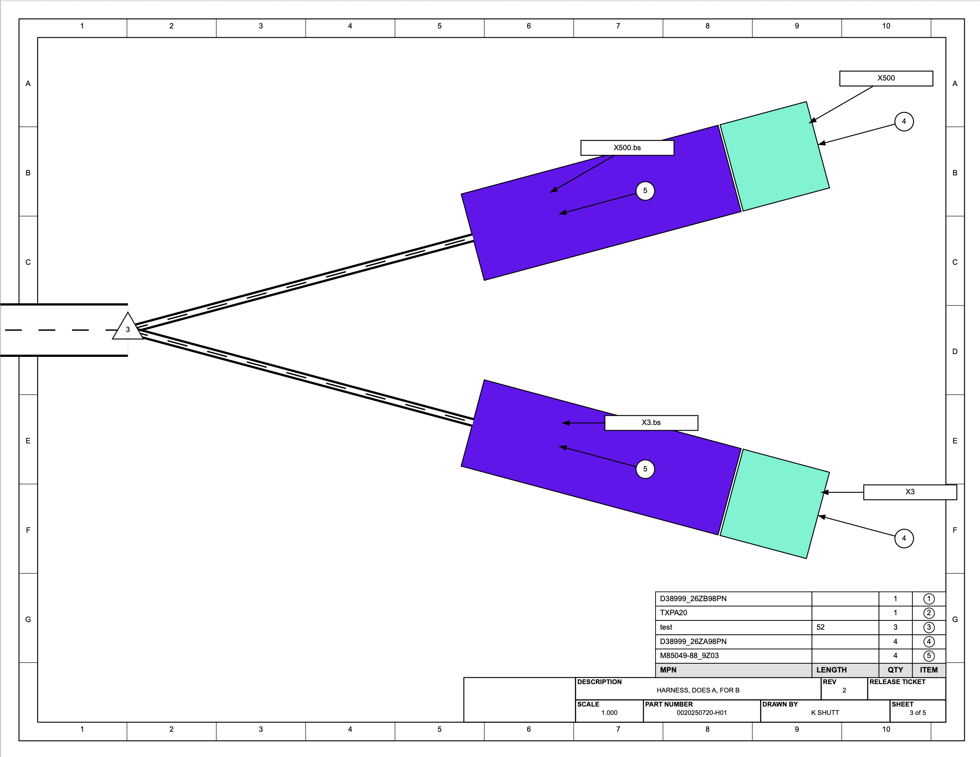
Another page shows a 1:1 scale view on a 8.5”x11” sheet.
Connectors and backshells shown here are just rectangles, but could easily be photos or CAD screenshots.
Flagnote positions are not well-defined, but can be configured as needed.

Slide 27
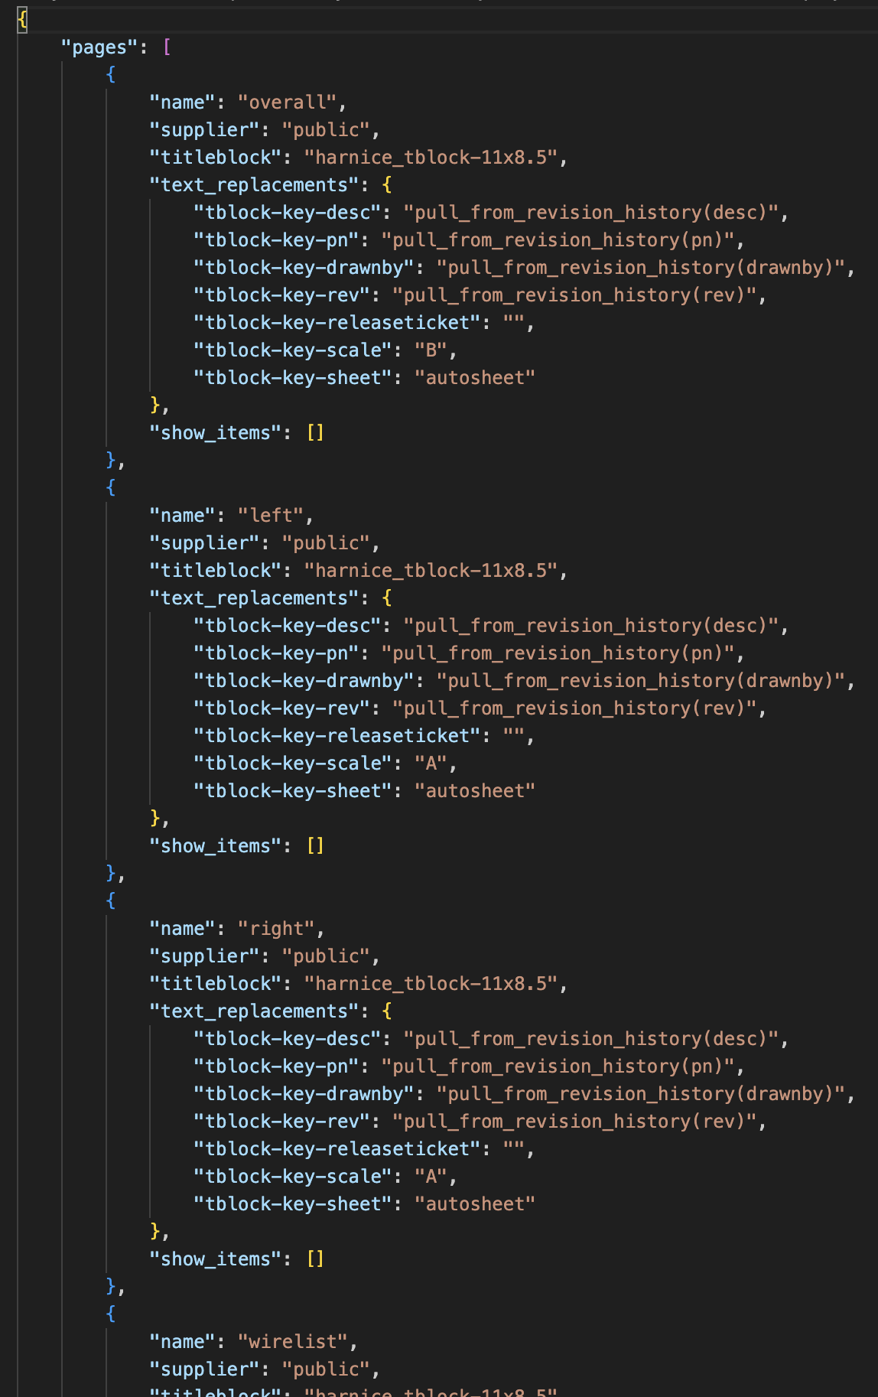
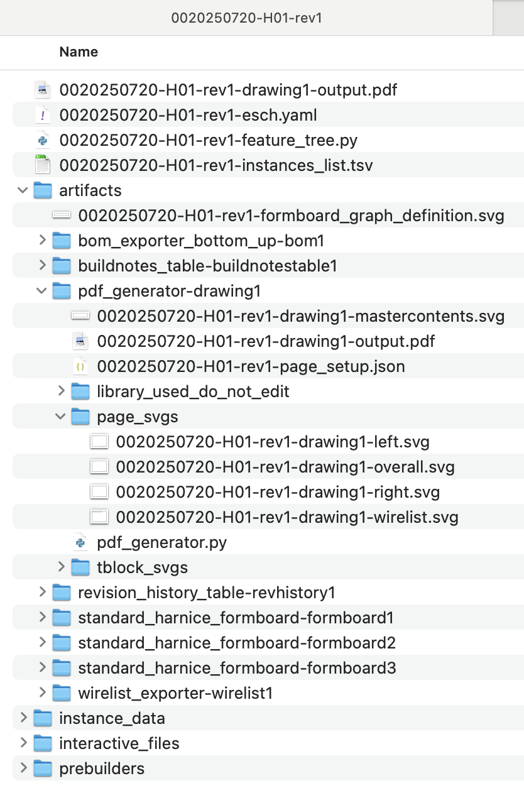
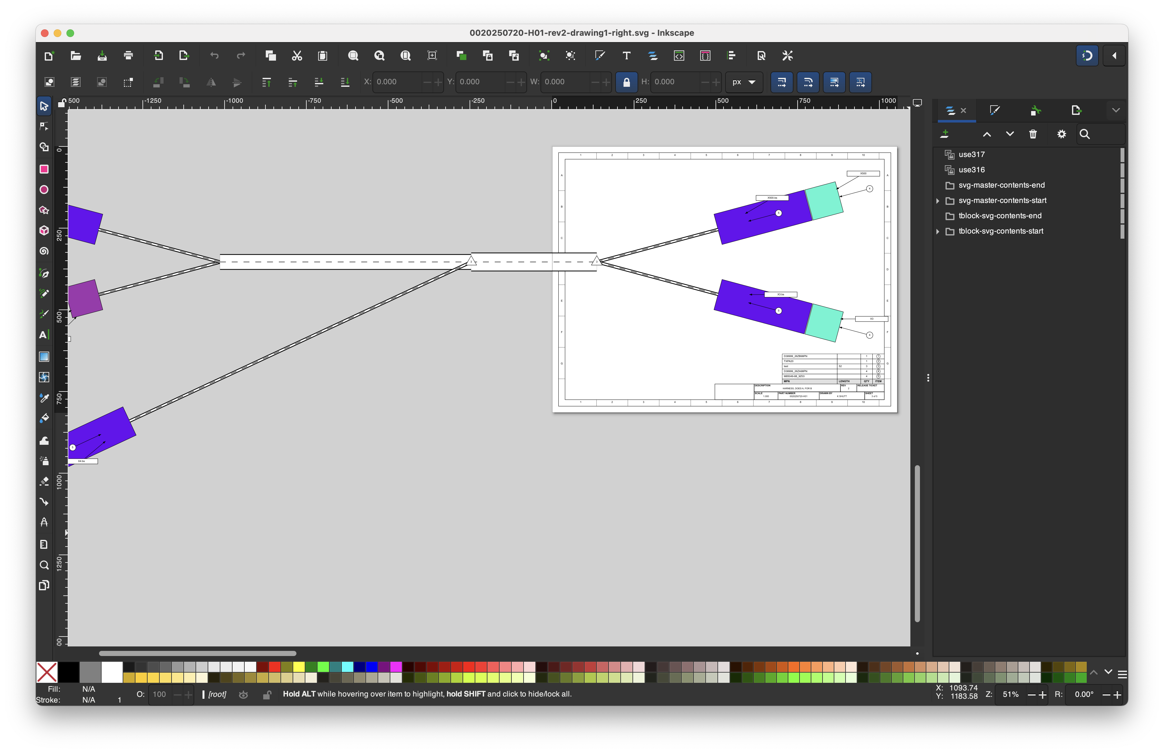
Pages can be edited with your favorite SVG editor…

Slide 28
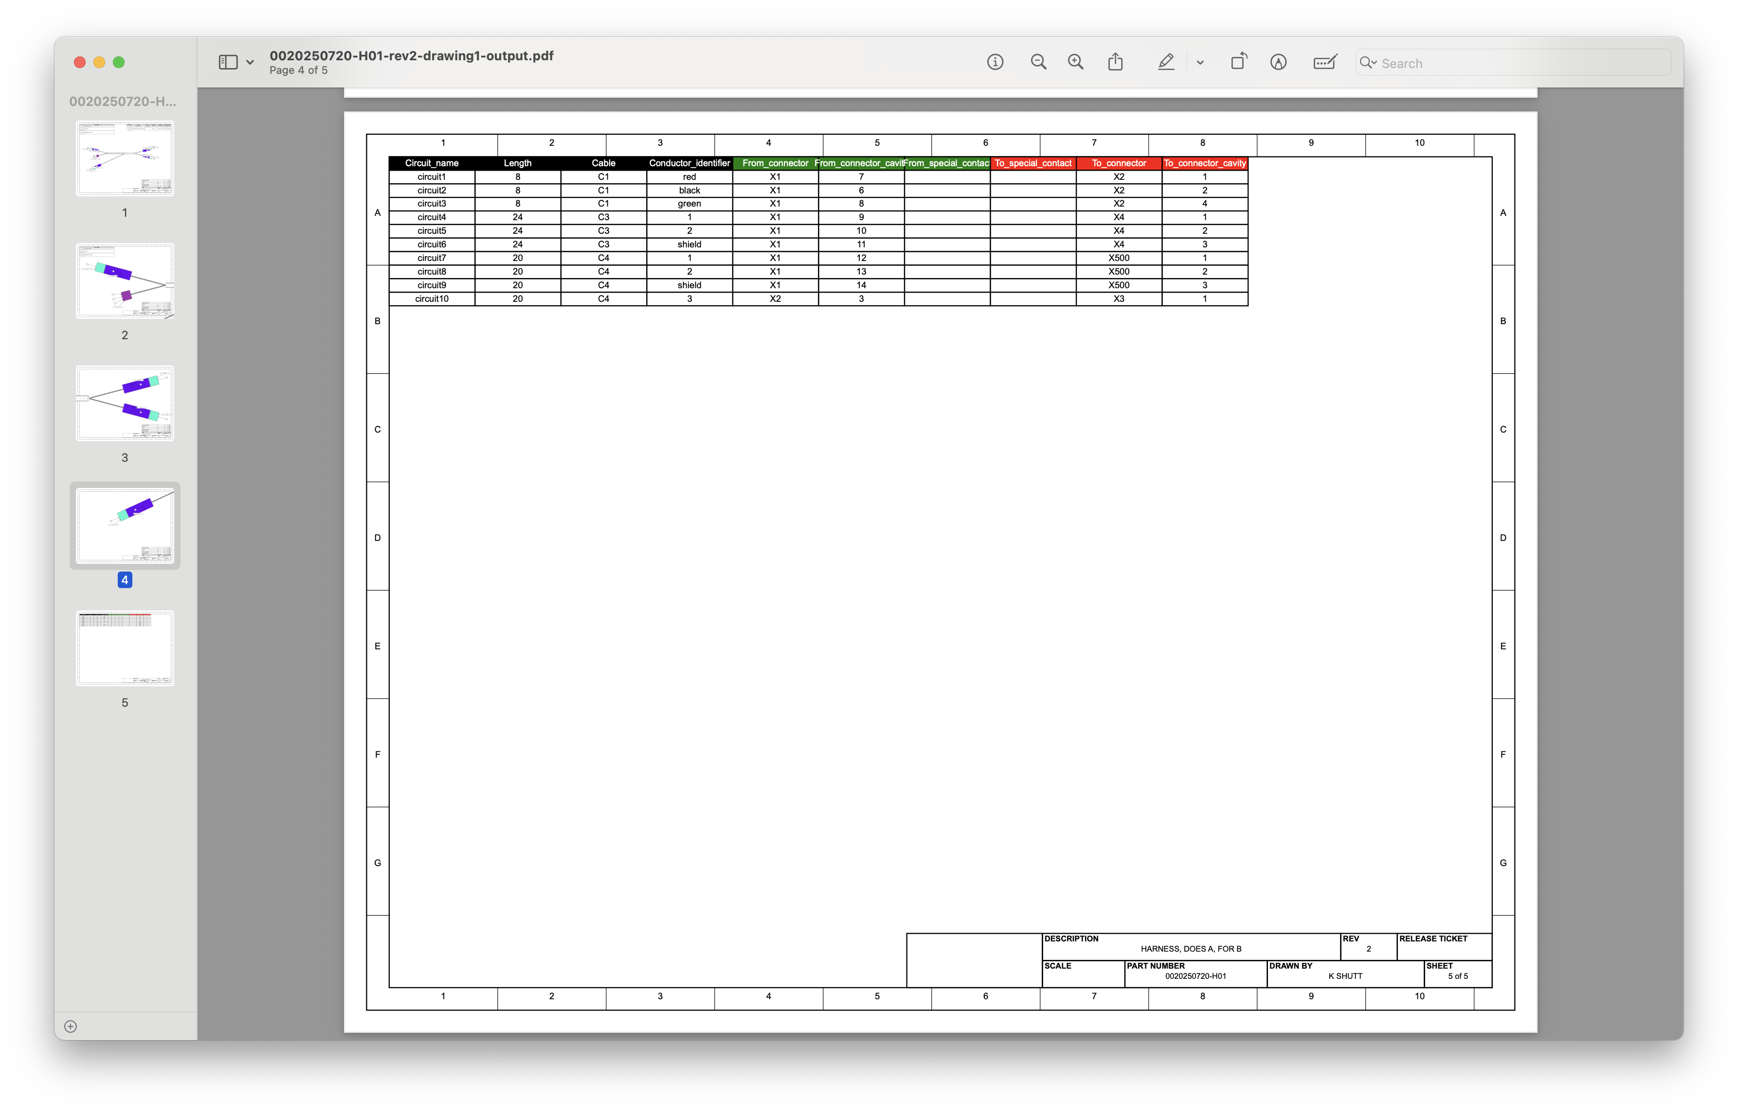
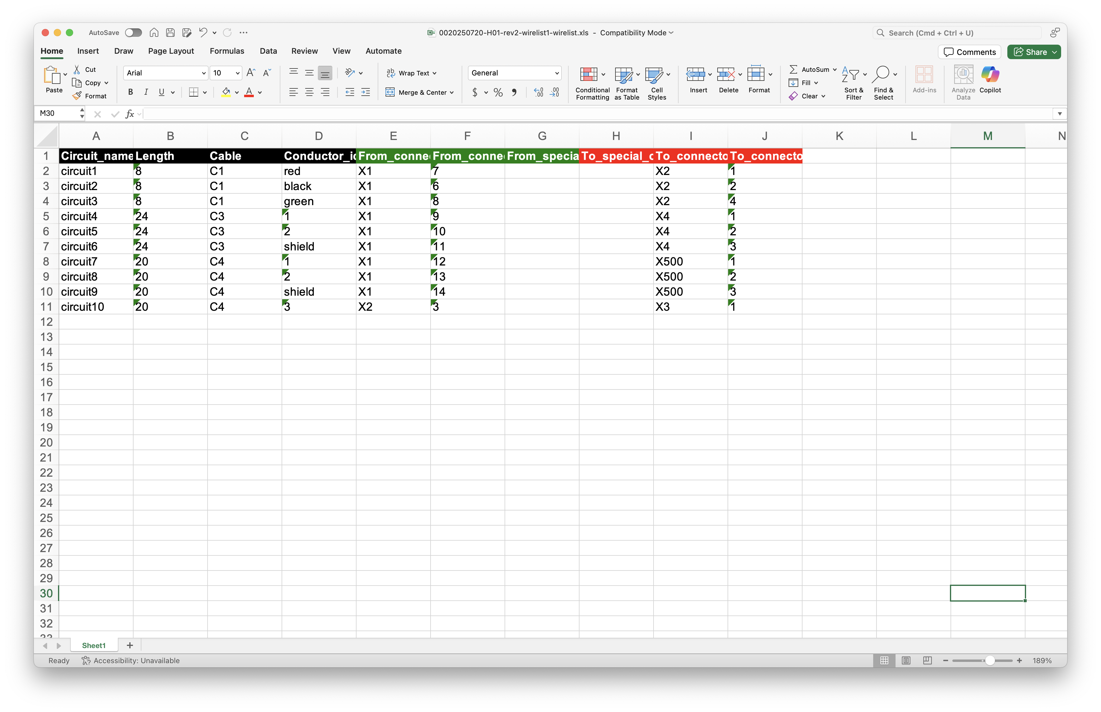
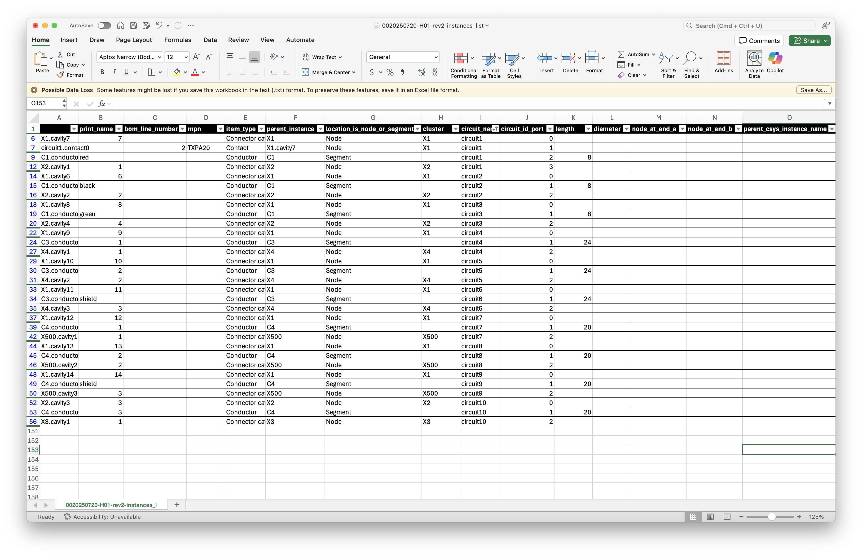
Of course…
All output artifacts are perfectly in sync with the Instances List

Slide 29
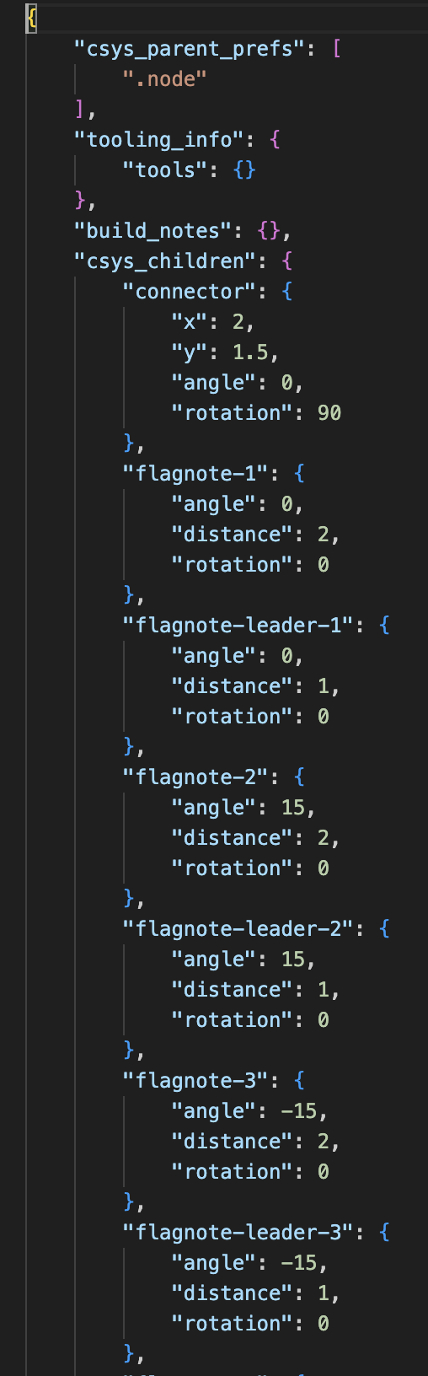
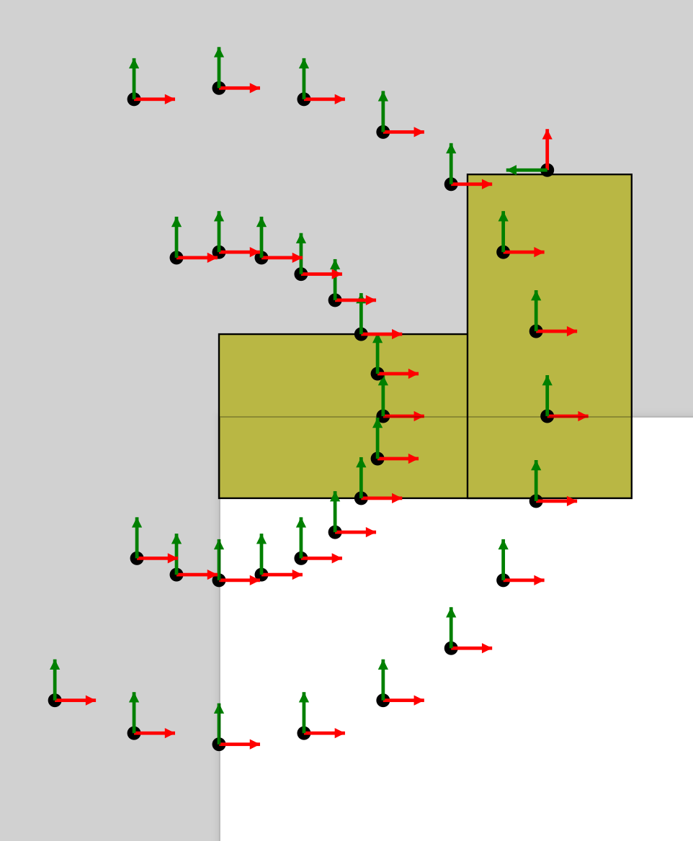
Every part can have as many child coordinate systems as you need
These can be referenced in the instances list
Used for things like flagnotes, child parts, or other related items
Can be used to place parts on a formboard drawing, calculate distances, etc

Slide 30
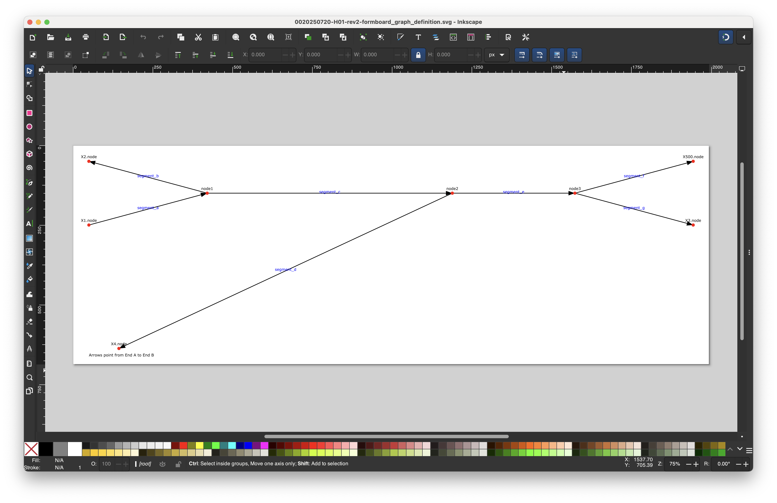
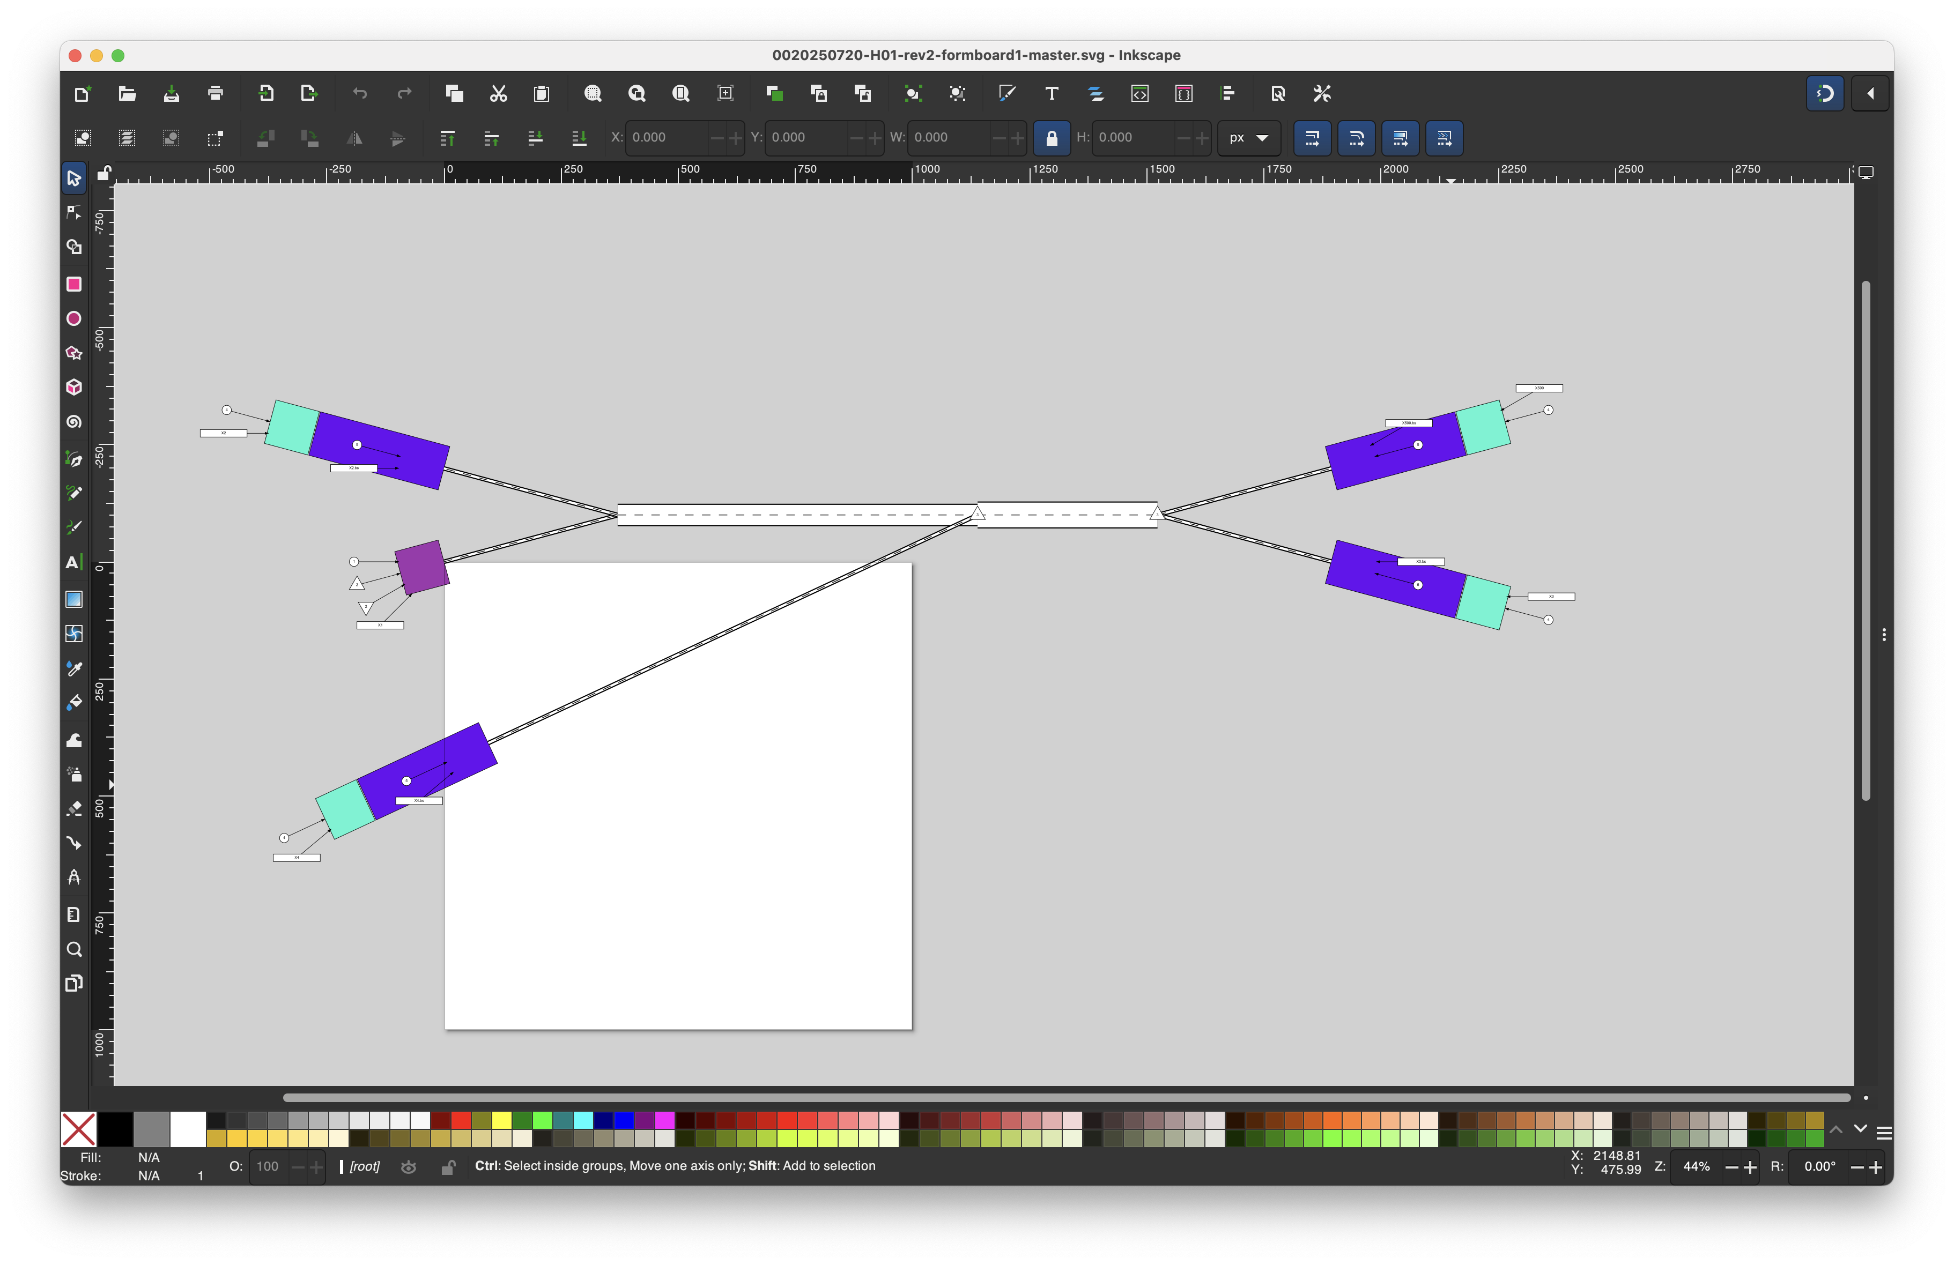
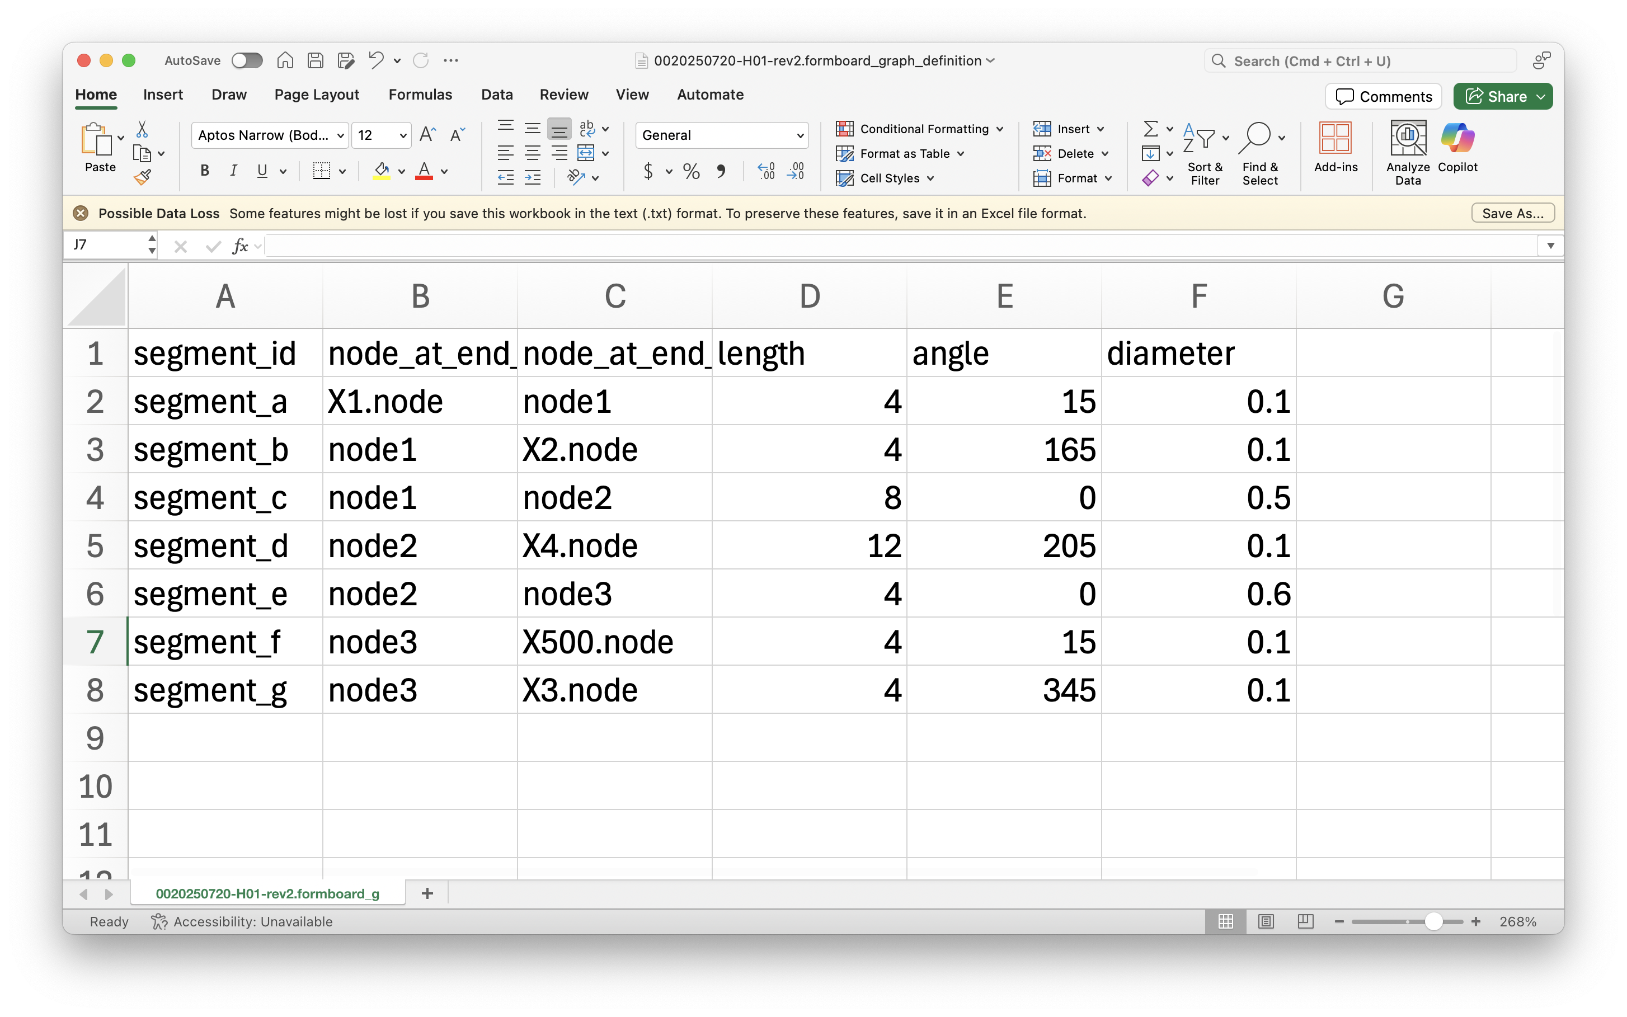
Defining a physical layout
For now, formboard_definition.tsv allows user to input length and angle preferences
These sync with cables and requirements from instances_list
Eventually, I’ll make a GUI

Slide 31
Interesting problems with Harness Builder
Revision control
Mapping harness reference designators to harness part numbers

Slide 32
Interesting problems with Harness Builder
Mapping nets to harness part numbers
There’s no guarantee that the user finds it useful to make a build part number out of every net. Assigning nets to harness part numbers is an engineering judgement call that Harnice will not solve for the engineer.
A system will produce a set of nets
For each net you find useful to make into a harness, make a part number first, and direct that part number prebuilder towards that net
Example
Your system contains a bunch of COTS harnesses (cat6 ethernet cables)
Harnice system will render each instance as a separate net
There’s no need to make a separate part number or harness drawing for each of those nets

Slide 33
Interesting problems with System Builder
Channel maps
Just because you have a net that contains multiple connectors, that is not enough information to define which channel connects to where
If you have a net, you know the signals and channels of the net’s connectors, and you know the compatible channel list, Harnice can produce a list

Slide 34
Interesting problems with System Builder
Transmission line effects
Given that

Slide 35
Interesting problems with System Builder
Harness disconnects

Slide 36
Things I learned about coding
Git
Fileio.path()

Slide 37
Infinite possibilities

Slide 38
Where are we as of today?

Slide 39
Where I want to take this

